Slide 1
Data Preparation for Accounting
Module 1
Ron Guymon & Linden Lu

Slide 2
Agenda
Introductions
Live Session Quiz
Using Python Locally (On Your Machine)
Use Case Example
For Next Week
Tips for the High Engagement Assignment
Notes:
Transition: So, let’s get into the instructor and course evaluations…

Slide 3
Course Introduction
This is the second of a 3+ course journey
A few important preliminaries
Participation, assignments, grades, readings
Discussion boards
Office hours
Notes:
This is the second of a three-course journey. It really is a journey. We’ve learned a lot from trying to get people too far in one course because we’re excited about the topic:
This course introduces data analytics.
ACCY 576 will introduce Python.
ACCY 577 will get into machine learning in Python.
Optional ACCY 593 contains four case studies that allow you to apply analytics to different accounting situations.
Required statements
Emergency video: https://mediaspace.illinois.edu/media/t/1_bbti3ec5
Emergency handout: https://police.illinois.edu/dpsapp/wp-content/uploads/2017/08/syllabus-attachment.pdf
Academic accommodations
Review how grades are calculated.
80 points (8%) Live Session Quizzes. There will be a short quiz during every live session. These quizzes assess your understanding of the Coursera material as well as ask for your opinions. We will use the quiz results to guide the live session discussions. If you're not able to attend either of the live sessions, a link will be posted so that you can take the quiz at a time that's convenient for you as long as it's before the deadline.
640 points (64%) HE Programming assignments. These programming assignments (based on Jupyter Notebooks) are similar to and an extension of the Jupyter Notebook assignments that are posted on Coursera. Specifically, you will be asked to perform a greater number of coding tasks that require more thought than the tasks in the Jupyter Notebook assignments on Coursera. It is intended that you complete these notebook assignments after having completed the module's Coursera material and after either attending the live session or viewing the live session recording and before the deadline.
280 points (28%) Final Project. The final project will give you an opportunity to go through the CRISP-DM framework for analyzing financial data in Python. You will be given a dataset and will be asked to perform a number of tasks associated with understanding, preparing, and modeling the data. This final project will be made available during the week of module 5.
Late submissions of assignments made within one week after the deadline will be accepted with a 25% penalty. Submissions made more than one week after the deadline will not be accepted. Any exceptions will be at the discretion of the program. Faculty will determine the extension deadline for approved exceptions. Once the answer key is posted, late submissions are not accepted for any reason. When at all possible, requests for an exception should be made BEFORE the assignment deadline.
No final exam.
I expect you to have read the required readings so that you’re prepared to discuss them in class.
Optional readings probably will help you learn the material better, but I don’t intend for you to have to read the optional material to do well in the course. It’s just a good reference for when you want to make time to learn more about it.
Discussion boards:
Please post your questions and comments here. There’s a separate discussion board for issues that you’d like me to address in the live sessions.
Office hours
Fridays 6-7pm (central) for Ron.
Saturdays, 6-7pm (central) for Linden (correct?)

Slide 4

Who is Ron Guymon?
Husband and father
Accounting professor / data scientist
Lover of outdoor recreation
Notes:
Of course I’m an accounting professor. Here’s some other relevant information.
Something interesting/funny/inspiring about my family: Twins
Share a bit about my path to being here at Rice. We all have different paths. Some academics start in business and then come to academics. I’m kind of the reverse: BYU -> Iowa PhD -> Georgia and data driven decisions -> Numetric -> back to academics. So while I don’t have an MBA, I worked for small, growing companies, which cost a lot and was a great education.
Triathlons, camping (Just finished my fourth consecutive Klondike with scouts), BQ hopeful
Office hours, Fridays, 6-7pm (central), or by appointment.
Transition: Here’s a little bit about Linden…

Slide 5

Who is Linden Lu?
Husband and father
Computer science/Finance background
Software engineer and Instructor
Sports lover
Notes:
About my family: two boys, my wife is also an accounting professor.
I have bachelors degree from computer science, and masters degrees from computer science and finance. Worked as software engineer and consultant in many different industries. Joined the University of Illinois in 2017 and have been teaching data analytics since then.
I’m a sports lover, I used to play soccer, basketball, tennis, now I mainly golf and I’m a single digit handicap golfer.
Office hours, Saturday, 10-11am (central), or by appointment.
Btw, I expect most of you to take the next course in data analytics specialization, Machine Learning for accounting with python. If so, you will see me again since I’ll be the instructor for that course.

Slide 6
Live Session Quiz
https://forms.gle/tktYJiXEULf3sMPv7
Notes:
Survey url: https://forms.gle/tktYJiXEULf3sMPv7
What is your first and last name?
Moral machine dilemma.
Coursera components completed
Three best topics for live sessions
What do you hope to achieve?
What are the biggest obstacles?
Transition: Let’s start by talking about Macros…

Slide 7
Questions About Coursera Content?
Notes:
Review some of the required readings:
First reading
Cognitive automation in banking (similar to what I did for Altaray). Give this scenario to students and ask how they would approach it.
Advanced analytics in travel and leisure (use internal and external data to identify customers most likely to accept)
Advanced analytics in consumer products (Used Tableau to identify cost-savings opportunities in IT)
Predictive analytics in insurance (combined many people and data from many sources (sensing devices, fitness trackers) to predict losses and price products.
Second reading: Who determines ethics
Artificial stupidity
Example of how GPS helps us if we pay attention to it
How do you operationalize moral decisions?
Moral Machine for crowd sourcing moral dilemmas (Good quiz question)
Third reading: Accountants with Data Analytic Skills are Difficult to Find
Lists some technical skills that are needed (identifying key trends, statistical modeling).
The ability to train in-house is really important. It’s the most effective way, but isn’t offered very often
Terms to define:
Terminal
Scope
Inline
Server
Navigating Coursera
Submitting assignments
Quizzes
Navigating the files on the Coursera server
Clicking on the Coursera icon, or the File menu to see the directory of what can be accessed.
Transition: Let’s talk a little about how to use Python locally, which means on your personal machine…

Slide 8
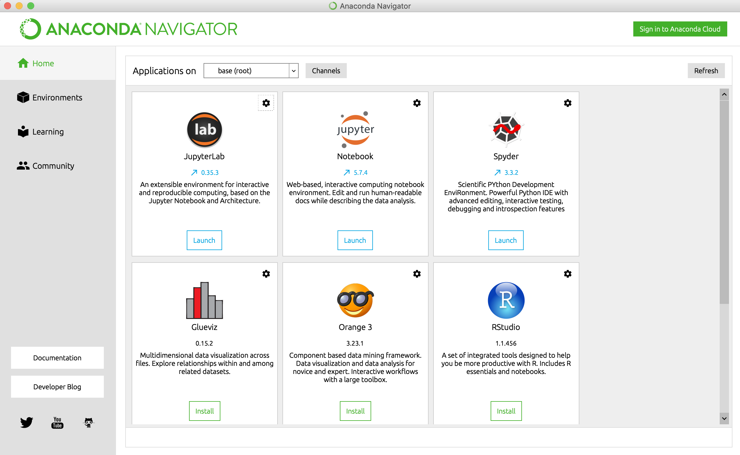
Using Python Locally
Anaconda Distribution
Anaconda Navigator
Notes:
Using it locally is helpful because you can easily load large files.
Instructions for installing Anaconda are on Coursera
Let’s look at the navigator and talk about the top three applications: JupyterLab, Jupyter Notebooks, and Spyder. When is each one useful?
Transition: First, let’s look at a data analytic issue, and briefly examine it using Excel. Then, we’ll show how to do the same thing in Python using Spyder, Notebooks, and Lab…

Slide 9
Use Case Example
Data Analytic Task in Excel vs. Jupyter Notebook
Notes:
Transfer to a screen share where I walk through steps in Excel, Spyder, and Jupyter Notebook (JupyterLab). This will help students get an idea of how to create and run Python code locally.
Use Vendors file
Excel
Highlight its uses, but also how the steps are not easy to remember or communicate. Walk through the creation of some of the data, but focus mostly on the clustering results. They can view more Excel tools in ACCY 569.
Spyder
Create a new file, but copy and paste a lot so that they’re not watching me do a lot of typing. Walk through the code at a high level. Focus on strengths of Spyder:
Set the working directory in the top right.
You can run the whole file, a cell, a selection, or line of code at a time. These are in the menu bar.
List of options and autocomplete. Show, for instance, when you type pd. After loading pandas, that the options show up. It makes it easier to run code.
Show them how you can also see the variables and dataframes in the Variable Explorer window.
You can run code in the console (bottom left) that you don’t want to keep.
You can highlight code and then press Command + I to see documentation in the bottom right help window. That window can also be toggled to a file explorer where you can open recent files from any program.
You can resize, undock/redock windows.
Jupyter Notebook
Walk through the code at a high level. Focus on communicating the results and figures, and share it with the students. Copy and paste code from the Spyder file. Focus on the strengths of notebooks:
Combining markdown cells with code cells, and with plots.
Shortcuts for navigating notebooks:
Enter and esc to toggle between edit mode and command mode.
M to change it to a markdown cell.
Y to change from markdown to code cell.
File Download as html (not editable) or ipynb file.
JupyterLab
This is a more full-fledged IDE for working in notebooks.
Collapse code cells (View -> Collapse Code Cells).
It’s an easier file explorer in my opinion.
You can see which kernels are running.
You can show the keyboard shortcuts on the screen as you’re working.
Transition: Let’s summarize the strengths of each data analytic environment…

Slide 10
Four Data Analytic Environments
Excel
Spyder
Jupyter Notebook
JupyterLab
Notes:
Ask students to summarize the strengths of each environment and type them on the screen.
Excel
Highlight its uses, but also how the steps are not easy to remember or communicate. Walk through the creation of some of the data, but focus mostly on the clustering results. They can view more Excel tools in ACCY 569.
Spyder
Create a new file, but copy and paste a lot so that they’re not watching me do a lot of typing. Walk through the code at a high level. Focus on strengths of Spyder:
Set the working directory in the top right.
You can run the whole file, a cell, a selection, or line of code at a time. These are in the menu bar.
List of options and autocomplete. Show, for instance, when you type pd. After loading pandas, that the options show up. It makes it easier to run code.
Show them how you can also see the variables and dataframes in the Variable Explorer window.
You can run code in the console (bottom left) that you don’t want to keep.
You can highlight code and then press Command + I to see documentation in the bottom right help window. That window can also be toggled to a file explorer where you can open recent files from any program.
You can resize, undock/redock windows.
Jupyter Notebook
Walk through the code at a high level. Focus on communicating the results and figures, and share it with the students. Copy and paste code from the Spyder file. Focus on the strengths of notebooks:
Combining markdown cells with code cells, and with plots.
Running on a browser and using a remote server.
Shortcuts for navigating notebooks:
Enter and esc to toggle between edit mode and command mode.
M to change it to a markdown cell.
Y to change from markdown to code cell.
File Download as html (not editable) or ipynb file.
JupyterLab
This is a more full-fledged IDE for working in notebooks.
Collapse code cells (View -> Collapse Code Cells).
It’s an easier file explorer in my opinion.
You can see which kernels are running.
You can show the keyboard shortcuts on the screen as you’re working.
Transition: Let’s summarize the takeaways from this first module…

Slide 11
Module 1 LE Takeaways
Data analytics is pervasive.
You should come to love IDEs.
Markdown is simple, but powerful.
Notes:
Data analytics is pervasive.
You should come to love IDEs. Learn the shortcuts
Markdown is simple, but powerful. Learn to think about how to communicate things to others. This stuff can get dense, so make it as easy as possible on others to read it.
Clustering is a powerful way to segment observations.
Transition: Let’s talk about two key takeaways from this high-engagement material…

Slide 12
Module 1 HE Takeaways
Anaconda is a great way to install the tools for running Python on your local machine.
Each IDE serves a different purpose.
Notes:
Different IDEs for different purposes:
Excel is easy to interact with in a point-and-click manner, but can be inefficient for processing large amounts of data and for automatically running scripts.
Spyder is helpful for creating code.
Jupyter Notebook and Lab are great for combining code, text, and visualizations into a single document that can be sent to others.
The material in this high engagement lesson is meant more for practical use and to answer questions. For purposes of what will be graded, you’re expected to know how to use Jupyter Notebooks. You’re NOT expected to know how to use VB Editor, Spyder, or JupyterLab. I hope these things are helpful, though.
Transition: Let’s talk about specifics of the last milestone that’s due by one week from today…

Slide 13
Module 2 Preview
Python
Python Functions
Conditional Statements in Python
Notes:
As promised in ACCY 569, we’ll be covering some of the same topics that we ended with in that course, but discussing them in Python.
A history of Python, and an overview of how it’s used.
Specifics of functions, which are like macros.
Specifics of conditional statements in Python.
Transition: Linden will now share some tips for completing the first high engagement programming assignment…

Slide 14
Tips for Module 1 High Engagement
Notes:
Linden will communicate the tips here.

Slide 15
Questions?

